Slide 1
CS550: Massive Data Mining
Movie Recommendation System
Aditya Maheshwari
Ronit De
Ezhil Nikhilan C
Team: 30

Slide 2

Problem Statement
Build A Movie Recommendation System based on the “MovieLens” dataset.

Slide 3
Dataset
MovieLens (Small) dataset
Ratings: ~100,000
Movies: ~9000
Users: ~600
Dataset Augmentation: TMDB(The Movie Database) database web-scraped for retrieving auxiliary movie content information like Plot, Cast and Director

Slide 4
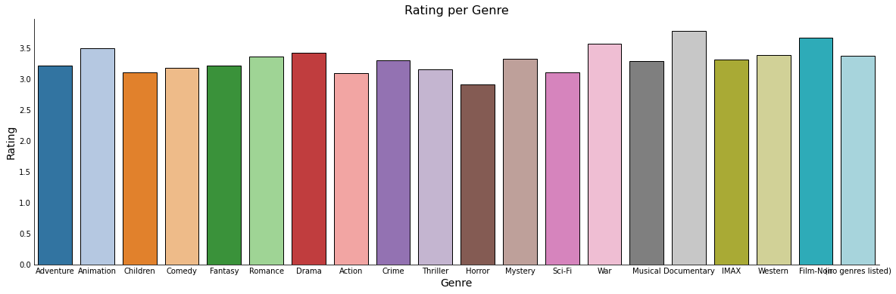
Analysis of the Dataset
Shows average rating of each genre
Gives indication of how likely movies of that genre is to be recommended to user based on the rating they give to that genre and the weights of the mean genre ratings

Slide 5
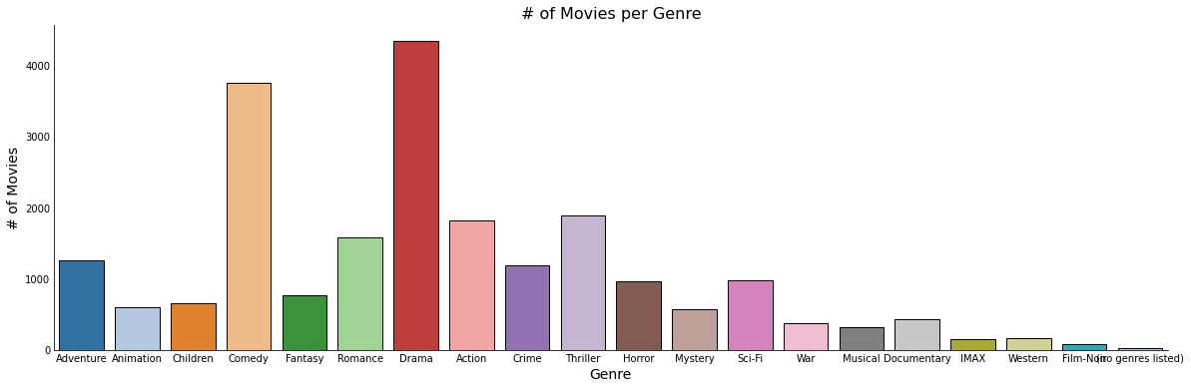
Analysis of the Dataset - 2
Demonstrates most frequently rated genres
Gives indication of how popular the particular genre is and how likely movies from that genre is to be recommended

Slide 6
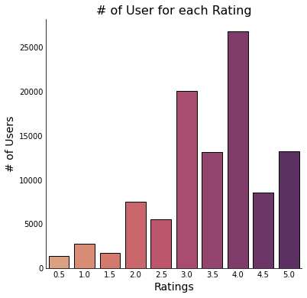
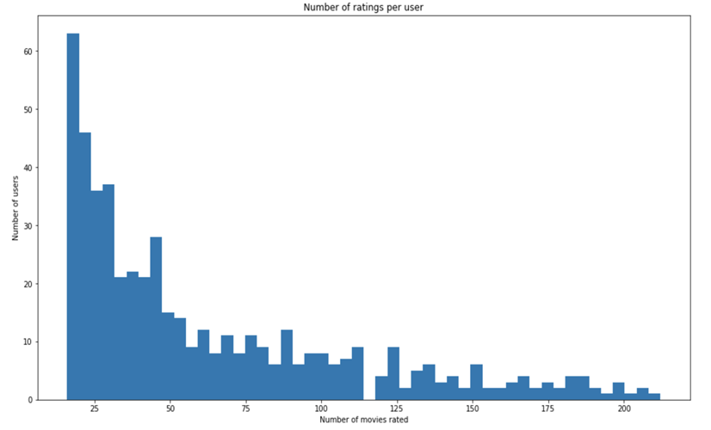
Analysis of the Dataset - 3

Slide 7
Recommender Systems Models
Vote-based/Popularity model
Content based model
Collaborative Filtering
Matrix Factorization method
Combined model ( Collaborative Filtering + SVD/NMF)

Slide 8

Vote-Based/Popularity MODEL
New users/ users with no rating
Crowd sourced data to augment the results.
IMDB ranking method for choosing TOP 250 movies.
Dataset: TMDB-5000

Slide 9
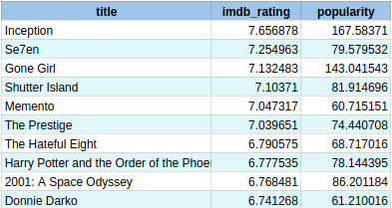
Vote-based/Popularity MODEL (RESULTS)
title | imdb_rating | popularity
Forrest Gump | 7.493812 | 138.133331
Titanic | 6.970261 | 100.025899
Her | 6.942697 | 53.682367
Eternal Sunshine of the Spotless Mind | 6.879048 | 56.481487
The Theory of Everything | 6.772112 | 61.182331
Amélie | 6.77195 | 73.720244
The Fault in Our Stars | 6.729273 | 74.358971
The Notebook | 6.680836 | 55.109138
A Beautiful Mind | 6.671066 | 59.248437
The Perks of Being a Wallflower | 6.664045 | 43.444135
Top rated "Mystery" movies
Top rated "Romance" movies

Slide 10
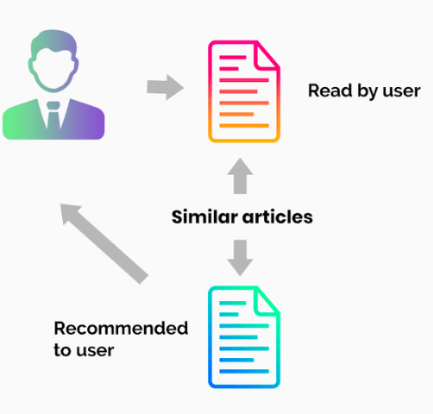
Content-Based Recommendation
User profile based on item profiles
Genre
Year of release of movie
Movie - Movie similarity

Slide 11
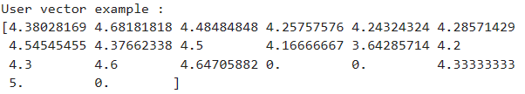
User & Item Vectors
Item/Movie Vector: Contains 0 or 1 based on applicability of a genre to a movie
For example,
User Vector: Contains value of average rating for each genre given by the user
For example,

Slide 12

Evaluation Metrics
Higher RMSE and MAE compared to the collaborative filtering techniques.
100,000 ratings for 600 users. Very few users with fewer ratings.
Collaborative filtering potentially works better.

Slide 13
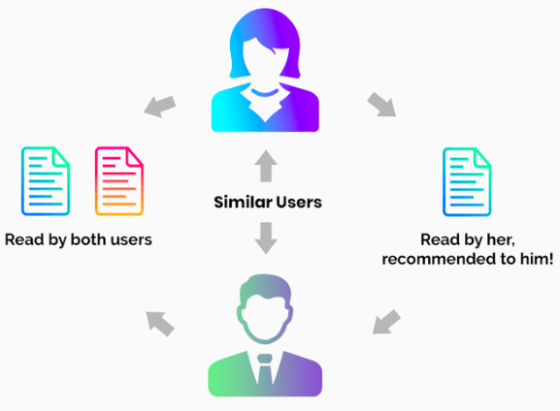
Collaborative Filtering
Models: (Surprise Library)
KNN Basic
KNN Baseline
KNN with means
KNN with Z-score
Co-clustering
SlopeOne
NMF ( A collaborative filtering algorithm based on Non-negative Matrix Factorization.)
Similarity Metrics: Cosine Similarity Mean square difference based similarity Pearson coefficient Pearson baseline

Slide 14
Latent Factor Methods
Matrix factorization based algorithms:
SVD : baseline estimates + latent factor predictions
SVDpp : SVD + considers implicit ratings
Hyperparameter tuning using GridsearchCV

Slide 15
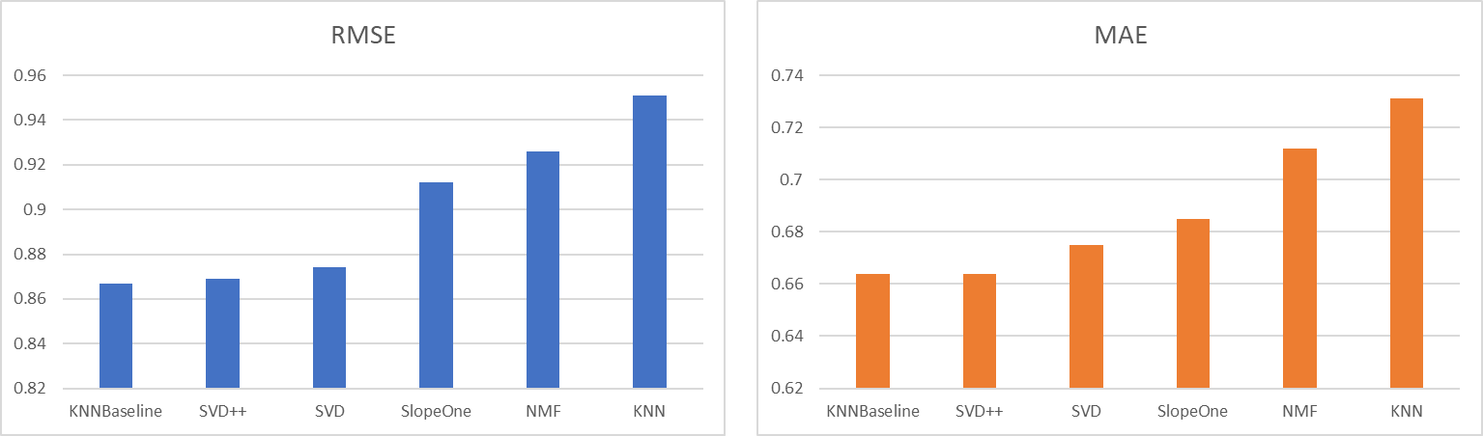
Comparative Analysis : RMSE vs MAE

Slide 16
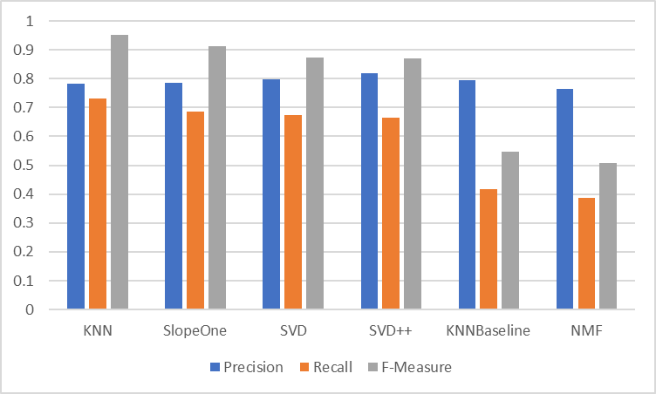
Evaluation of different algorithms

Slide 17
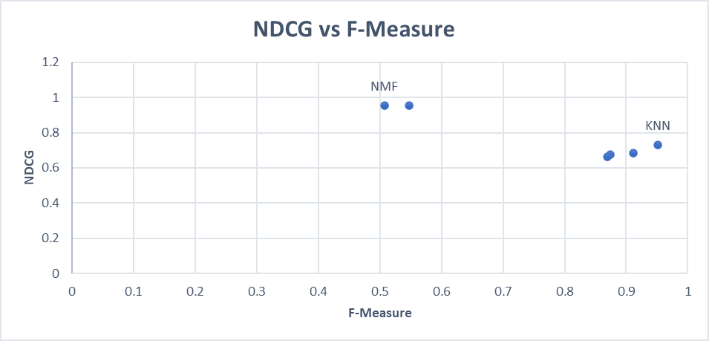
NDCG scores and trade-offs

Slide 18
User-User vs Item-item Collaborative filtering
KNN_Baseline | Item Based |  | User-based
Similarity Metrics | RMSE | MAE | RMSE | MAE
Pearson baseline | 0.8573 | 0.6718 | 0.8672 | 0.679
MSD | 0.8846 | 0.6943 | 0.8935 | 0.705
Cosine | 0.8929 | 0.7023 | 0.8997 | 0.7107
Pearson | 0.8884 | 0.6989 | 0.8946 | 0.7052

Slide 19
Combined Models
Combine the benefits of Collaborative filtering with other methods
Collaborative Filtering models :
KNN
Co-Clustering
SlopeOne
Combined with:
Matrix Factorization/NMF
SVD/SVD++

Slide 20
Weighted Combination Of The Best Algorithms
Other combinations under consideration:
KNN/Co-clustering + NMF
Co-Clustering + NMF/SVD

Slide 21
Conclusion
1) Collaborative filtering works better because very few users have <20 ratings. A large number of the users have rated 50+ movies ~ atleast 5% of the total number of movies.
2) Item-item collaborative filtering works better than user to user collaborative filtering
3) The accuracy of recommendations improve when the prediction of different models are combined

Slide 22


